Slide 1
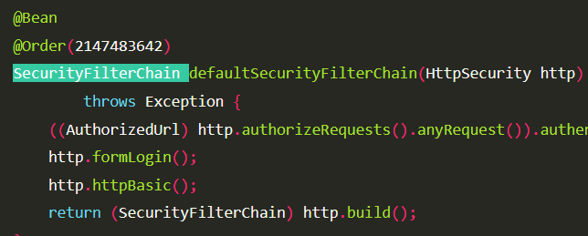
Spring security

Slide 2
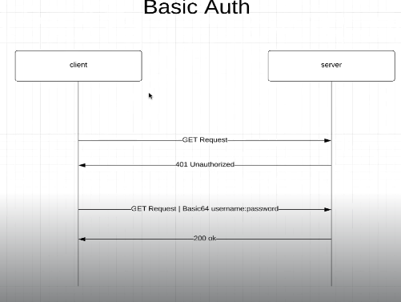
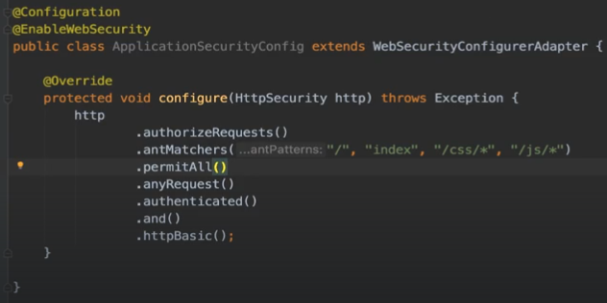
Spring security – default User (Basic auth)

Slide 3
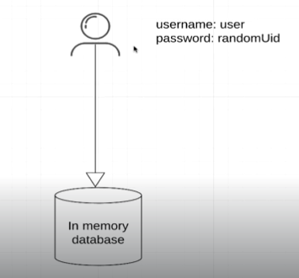
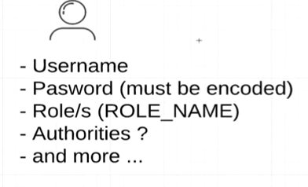
Spring security - User

Slide 4
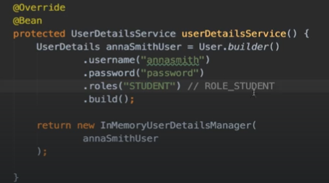
Spring Security In-Memory Authentication (New user list creation)

Slide 5
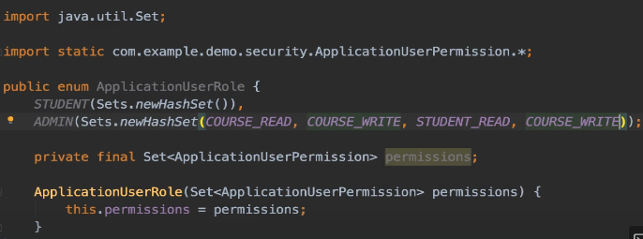
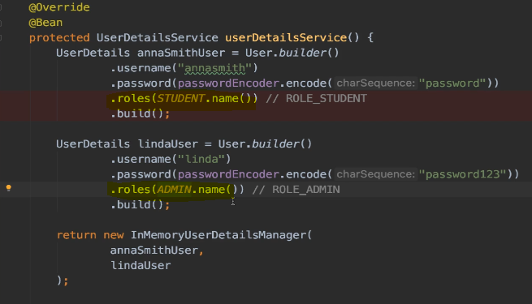
Role based Authorization

Slide 6
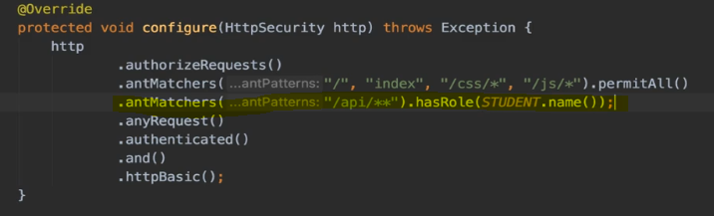
Role based Authorization

Slide 7
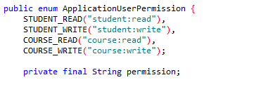
Permission based Authorization

Slide 8
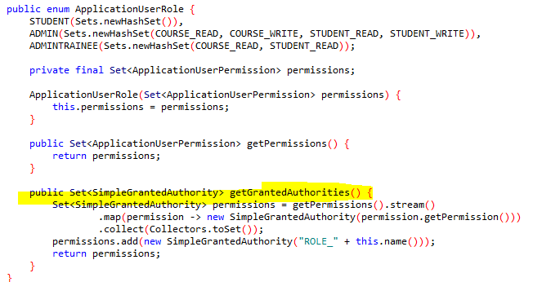
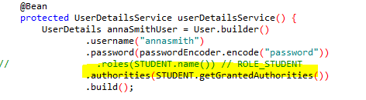
Permission based Authorization

Slide 9
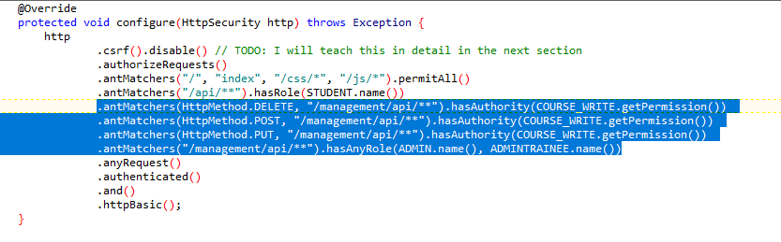
Permission based Authorization (Global config)

Slide 10
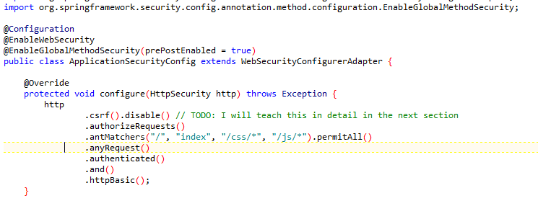
Permission based Authorization (method)

Slide 11
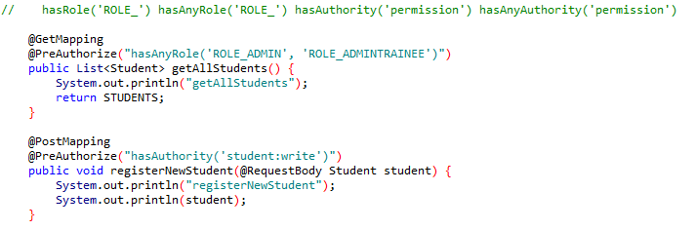
Permission based Authorization

Slide 12
Permission based Authorization

Slide 13
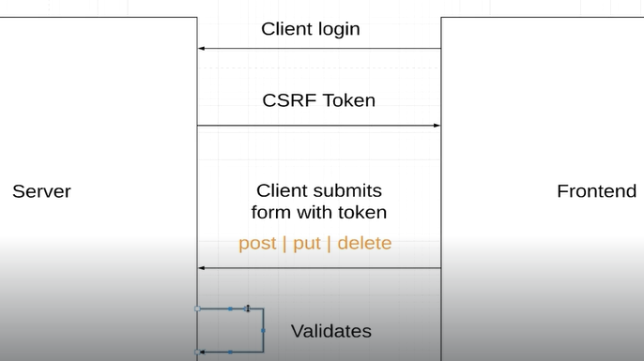
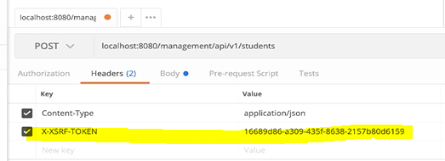
CSRF

Slide 14
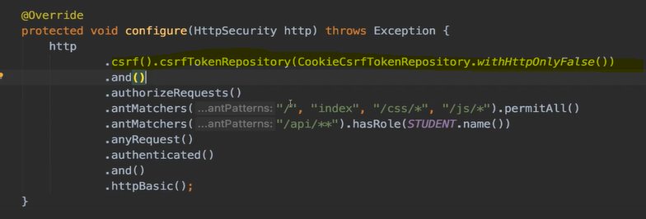
CSRF

Slide 15
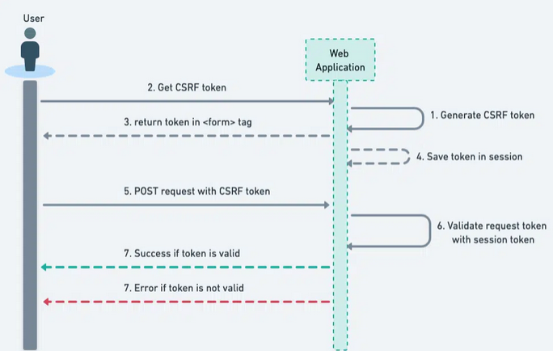
CSRF

Slide 16
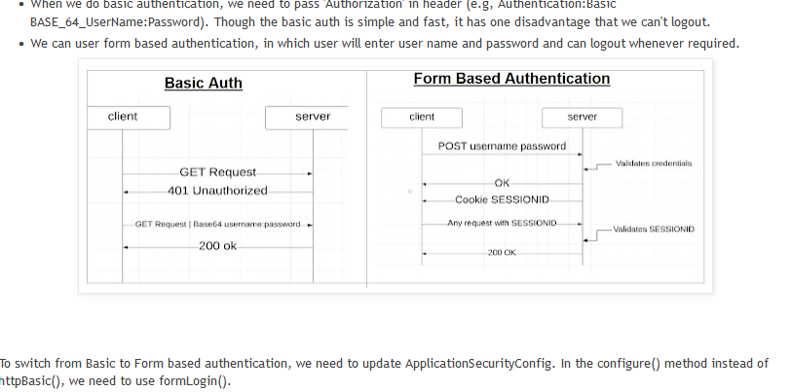
Form Based Authentication (Spring security default)

Slide 17
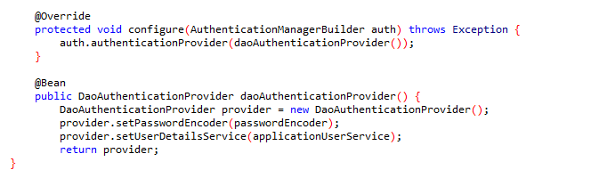
Database authentication

Slide 18
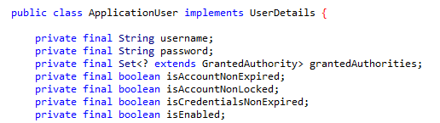
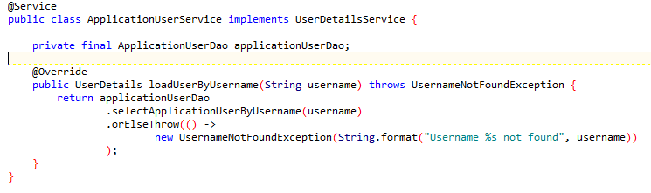
Database authentication

Slide 19
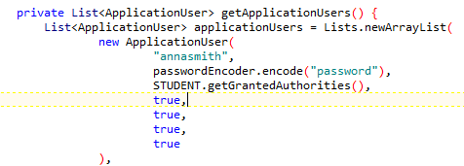
db user creation

Slide 20
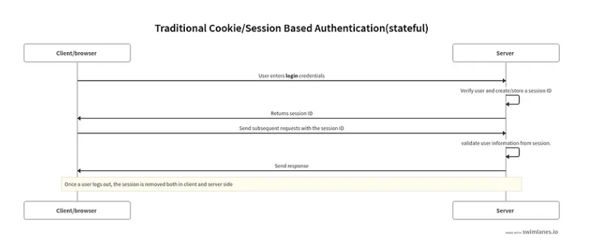
Statefull vs stateless token

Slide 21
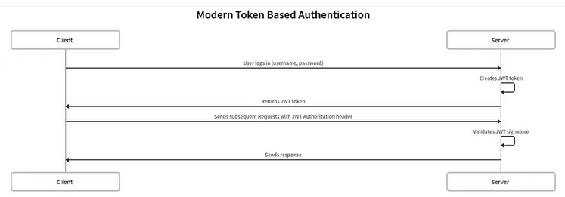
Statefull vs stateless token

Slide 22
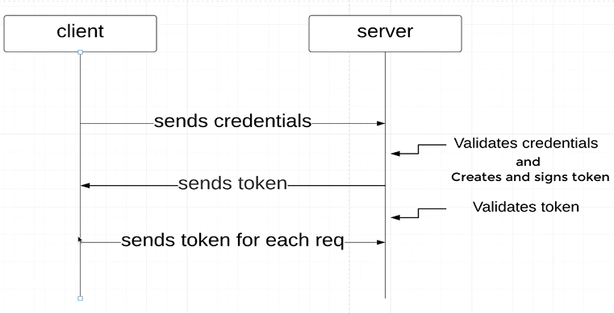
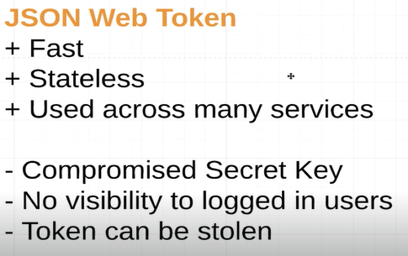
JWT

Slide 23

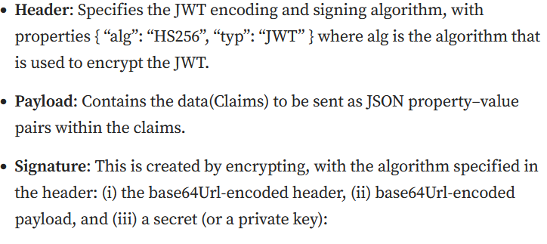
JWT

Slide 24
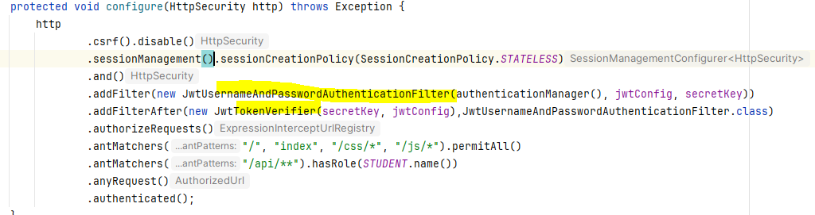
JWT
Send request with credentials
Validate credentials
Generate Token
Return generated Token
Send api request with Token
Validate token

Slide 25
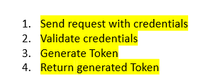
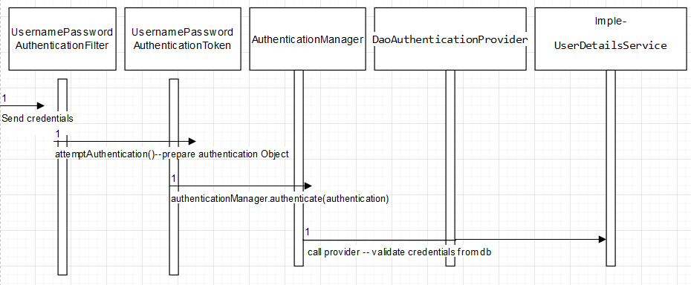
JWT –validate credentials
if header not contains a JWT.
Security Flow will call ---JwtUsernameAndPasswordAuthenticationFilter

Slide 26
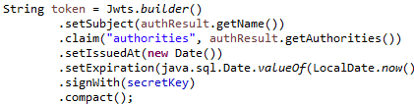
JWT –after success generate token

Slide 27
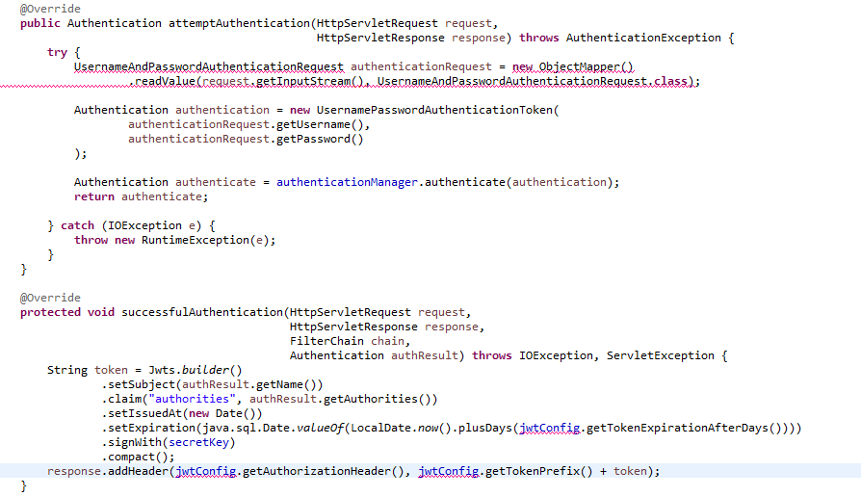
JWT (credential validation + token generation + return token)

Slide 28
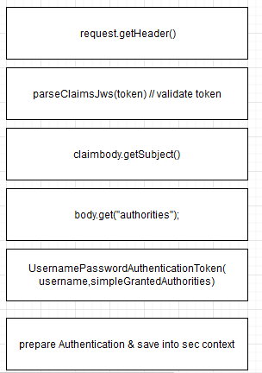

JWT –validate Token
if header contains a JWT.
Security Flow will call ---class JwtTokenVerifier extends OncePerRequestFilter

Slide 29
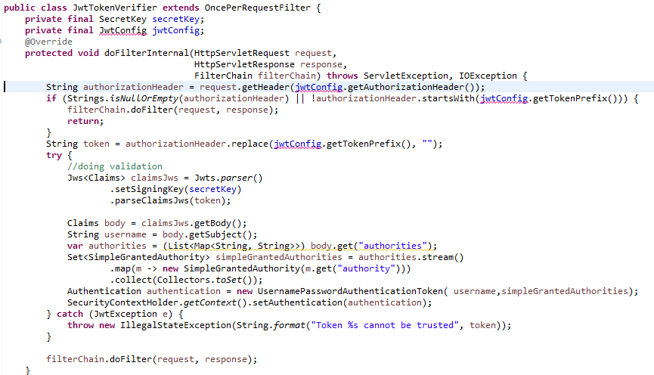
JWT (validate token + set security principle value in sec context)

Slide 30
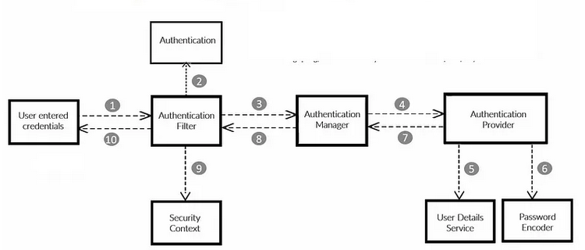
Spring security flow

Slide 31
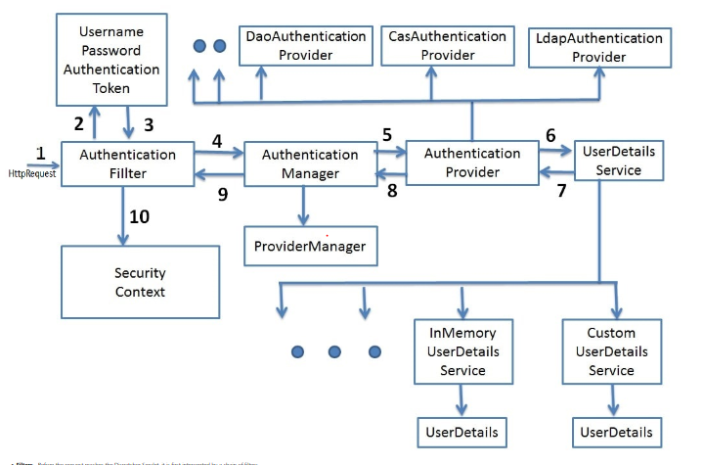
Spring security architecture

Slide 32
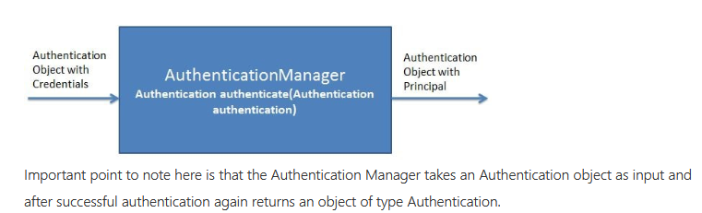
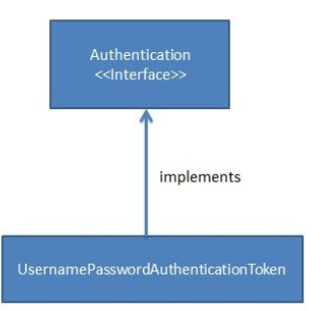
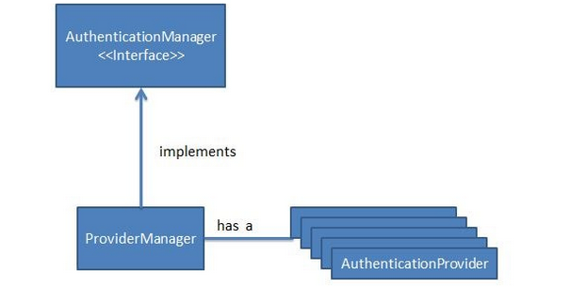
Spring security flow

Slide 33
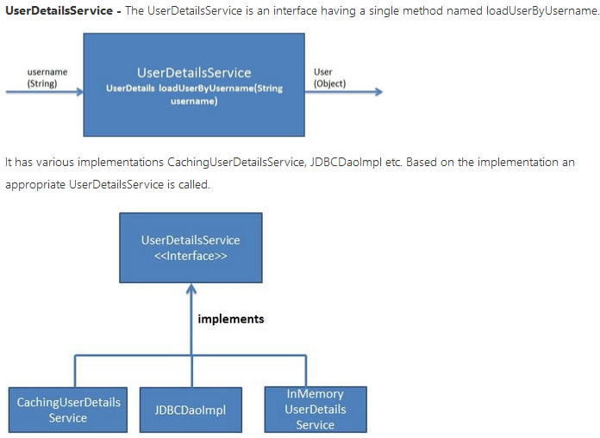
UserDetailsService

Slide 34
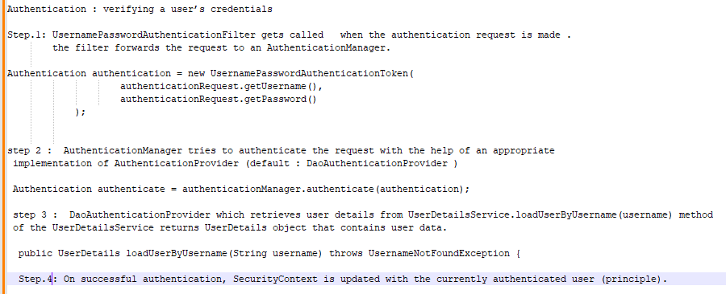
Interview Question --- Authentiation

Slide 35
Interview Question --- Authentication

Slide 36
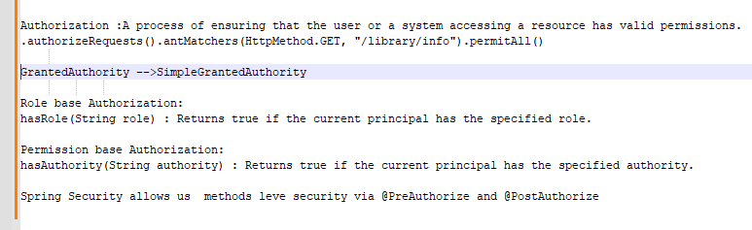
Interview Question --- Authorization

Slide 37
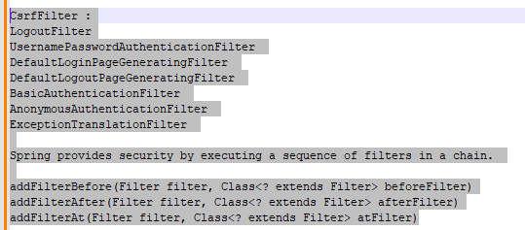
Interview Question --- Filter

Slide 38
Password Hashing.

